Slide 1
NLP Application Area Investigations - Natural Language Generation
IST 664 Natural Language Processing
Cherngywh Lee

Slide 2
Natural Language Generation Means Data Storytelling
NLG tools automatically analyze data, interpret it, identify the most significant parts, and generate written reports in plain English. In essence, NLG brings artificial intelligence to business intelligence (BI), automating routine analysis, saving business users time and money.
Although BI products generate visualizations, reports, and dashboards, business users still have to analyze and interpret data. That’s where NLG comes in. It automatically performs the analysis and generates an English language translation of what is significant and meaningful in the data. Business users no longer have to study the data to interpret its meaning; NLG tools do that for them.

Slide 3
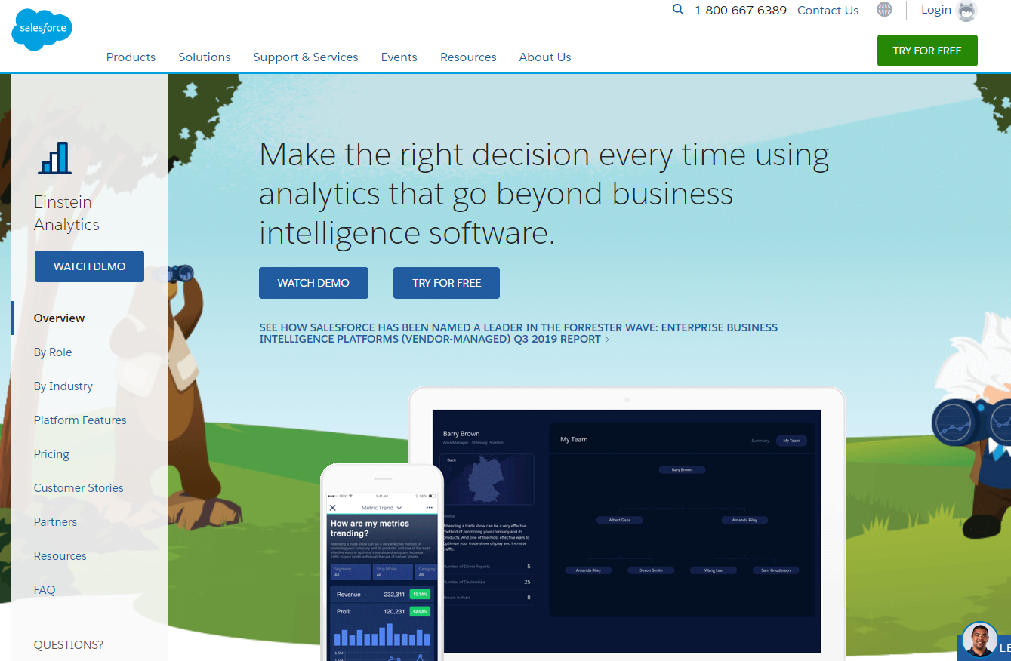
Salesforce – Einstein Analytics
Salesforce is a customer relationship management solution that brings companies and customers together. It's one integrated CRM platform that gives all departments — including marketing, sales, commerce, and service — a single, shared view of every customer.
Salesforce offers NLG as part of Einstein Analytics platform. Einstein Discovery — one of the Salesforce Einstein Analytics apps — is the core NLG for analytics offering. No setup or customization is required for Einstein Discovery NLG — descriptive, diagnostic, and predictive narratives are there whenever you pull up a metric or a dashboard.
Einstein Analytics - https://www.salesforce.com/products/einstein-analytics/overview/

Slide 4
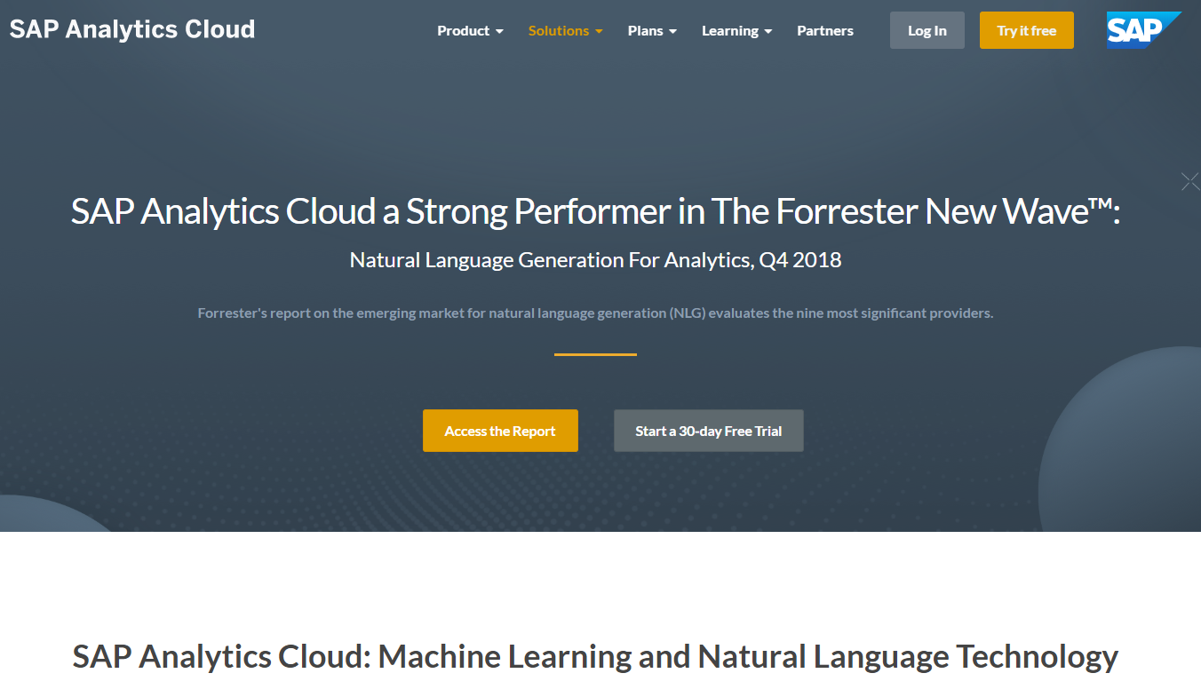
SAP – SAP Analytics Cloud
SAP SE (Systems, Applications & Products in Data Processing) is a German multinational software corporation that makes enterprise software to manage business operations and customer relations.
SAP embeds NLG capabilities into SAP Analytics Cloud (SAC), the report says. “The latest versions of SAC and one of its features (Smart Assist) come with natively embedded NLG — or, as SAP calls it, dynamic text, Smart Insights, and Smart Discovery.
SAP Analytics Cloud- https://www.sapanalytics.cloud/

Slide 5
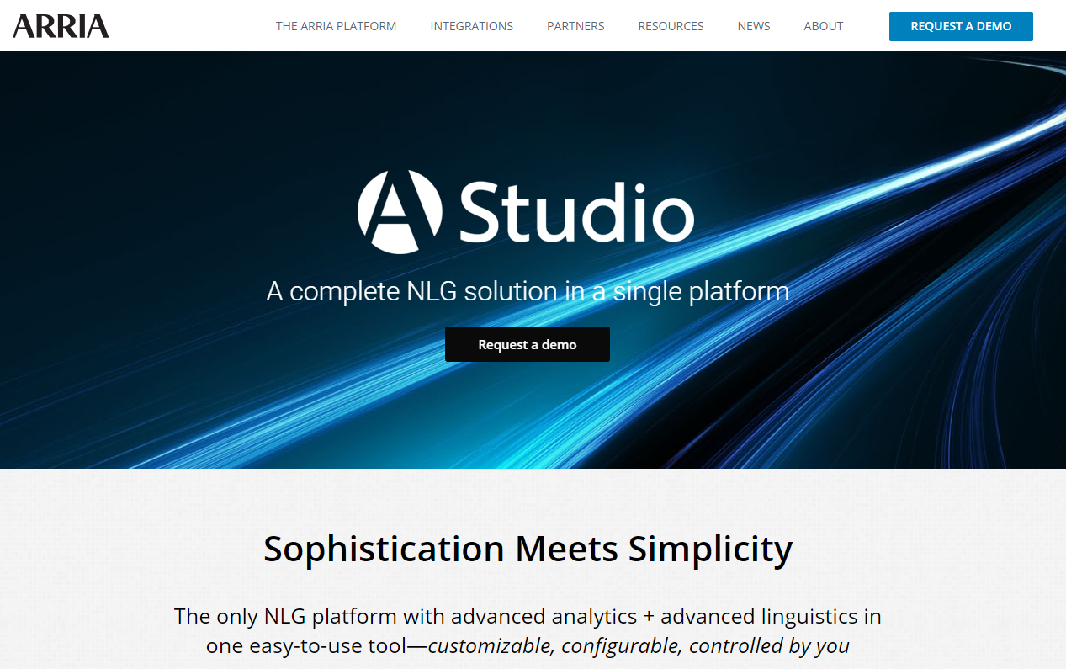
ARRIA NLG – Studio
ARRIA NLG PLC is the global leader in the field of artificial intelligence (AI) known as natural language generation (NLG). ARRIA owns, develops, and licenses its core, patented NLG technologies, which are available via the ARRIA NLG Platform.
It is one of the pioneering companies in the space of automatic text generation.
As a Leader with robust writing automation and analytics capabilities to be the most comprehensive among all participants.
ARRIA NLG - https://www.arria.com/

Slide 6
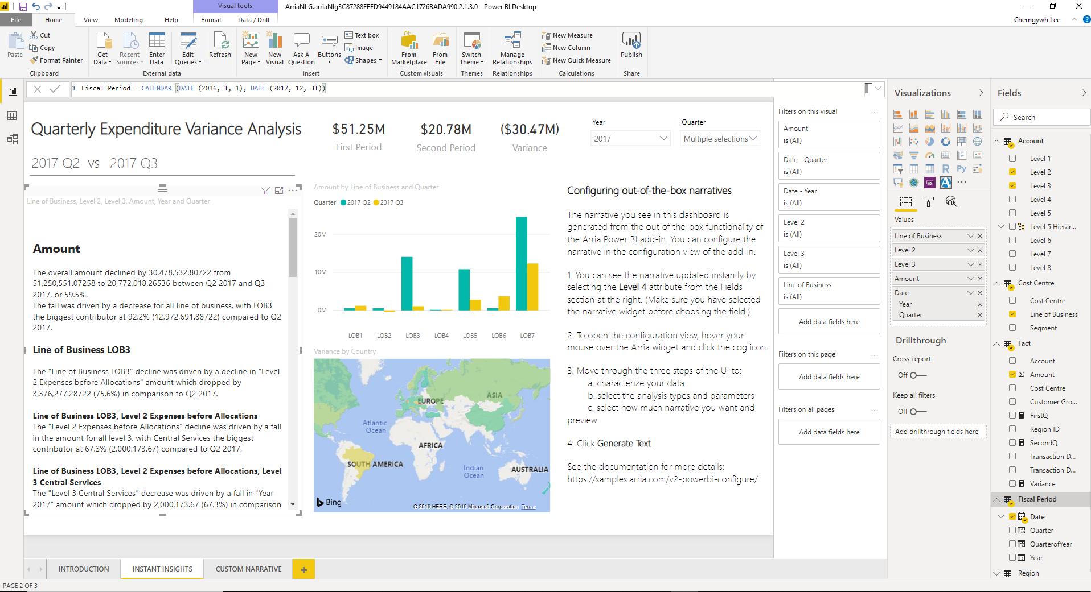
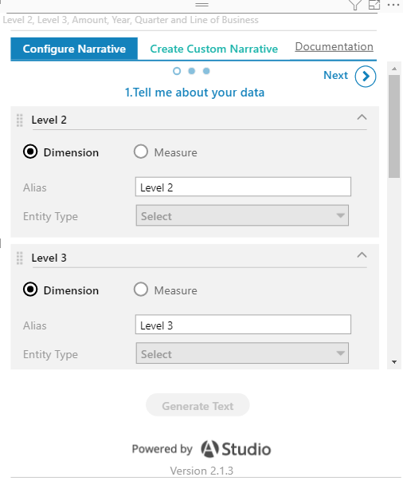
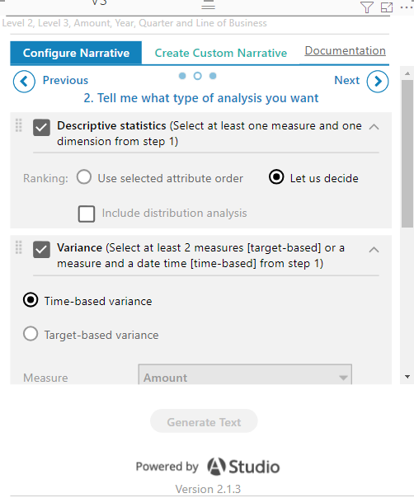
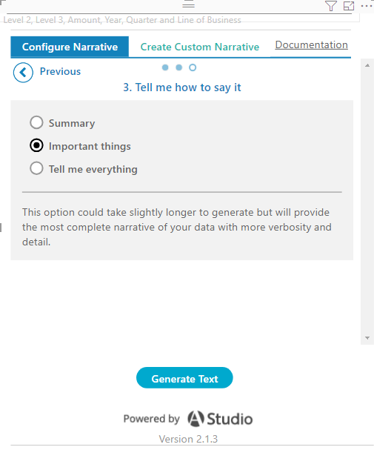
ARRIA Power BI add-in Example
To open the configuration view, hover the mouse over the ARRIA widget and click the cog icon.
Select a place to for narrative.
Select data for analysis in step 2.
Characterize your data
Select the analysis types and parameters
Select how much narrative you want and preview
3
1
2

Slide 7
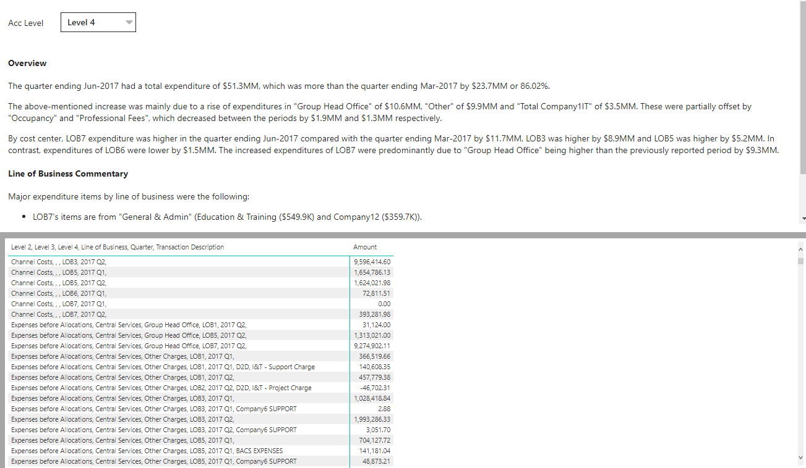
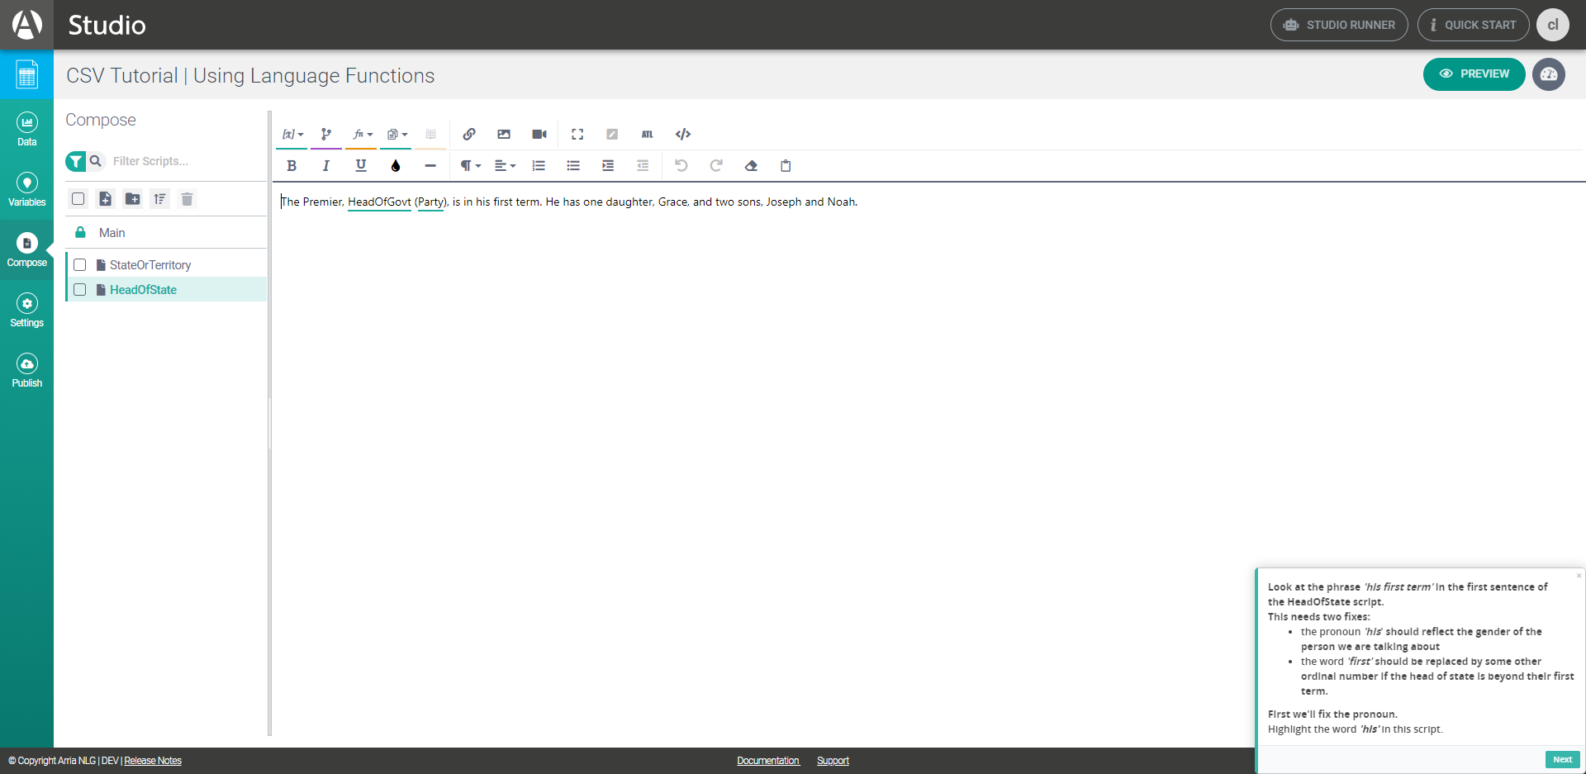
Narrative and Data
So, I requested a temporary license for students, and found that the original platform “Studio” is more like a smarter text editor.
The user still needs to construct a paragraph, then assign the variables to objects.
It should be convenient if we need to publish regular report in an identical fashion in the long run.
Finally we got the narrative for the analyzed data below.
I found that only numbers change when I selected different category, but the context is the same like a framework.

Slide 8
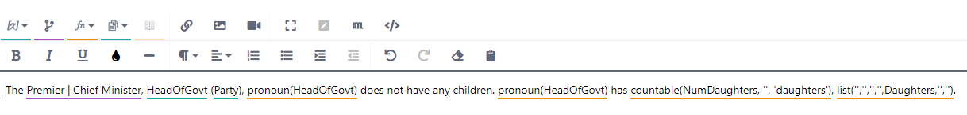
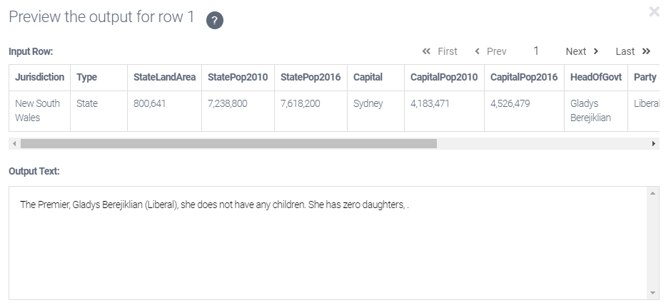
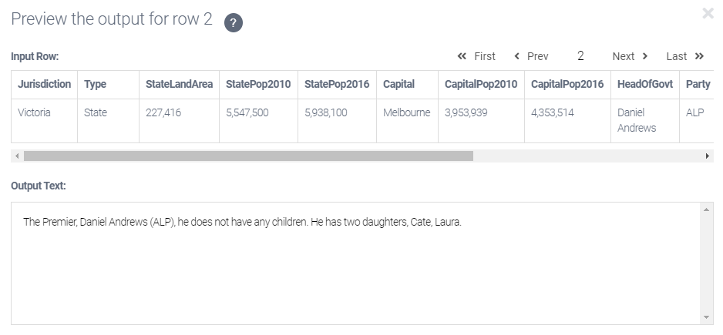
Example on Studio
Basically each row is a sub-dataset and we can assign a variable or a relationship to an object.
For example, if we assign a pronoun to a name, the system will check the gender of the name, then generate a corresponding pronoun (he/she). The sentence will automatically change when we switch rows.
The Premier, Daniel Andrews (ALP), he does not have any children. He has two daughters, Cate, Laura.
The Premier, Gladys Berejiklian (Liberal), she does not have any children. She has zero daughter.

Slide 9
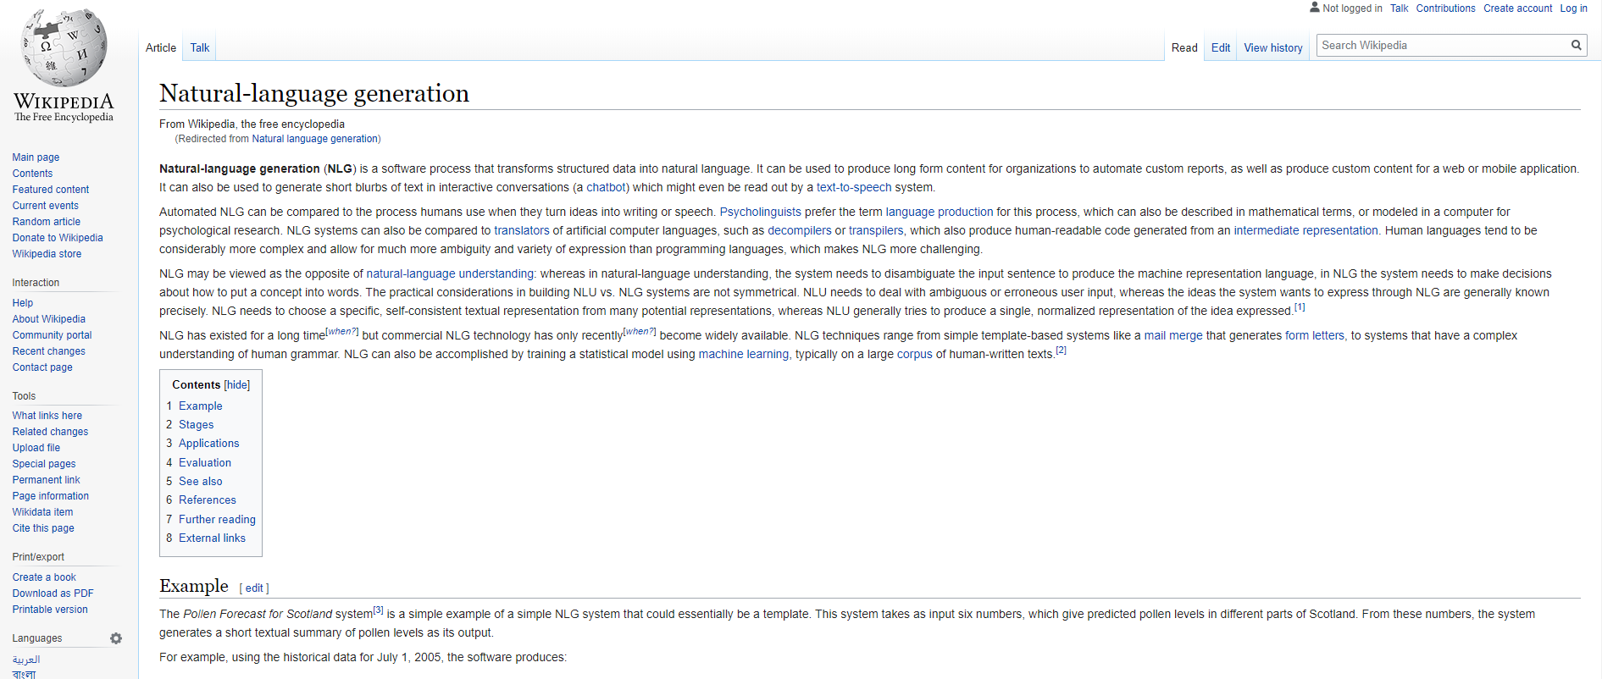
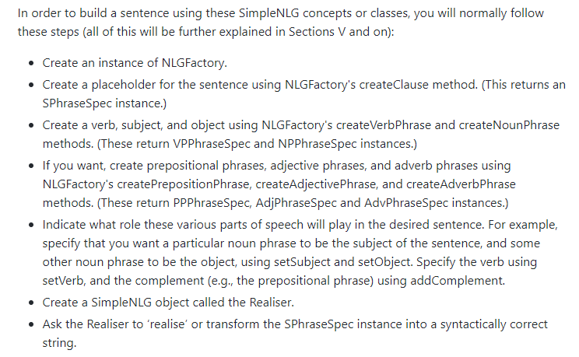
How NLP contributes NLG
Ehud Reiter is the chief scientist of ARRIA NLG as well as a professor of computer science at the University of Aberdeen.
He has a blog to discuss NLG and also teach people how to start to study NLG.
According to the Wikipedia he wrote and an open-source NLG software that he recommended. We can see the knowledge of NLP like lexicon, phrase types…etc. are necessary for building the architecture of NLG.

Slide 10
Issues or difficulties
Currently NLG application is still not able to substitute for a human to generate a meaningful narrative by itself. It’s more like an assistant to help controling quality or do some repeatable works.
Users must also understand the use cases.
For example, a financial analyst may use an NLG system to help write a report by automatically producing an initial draft of the report. In this use case, the goal is producing the final version of the report, and the context includes the analyst’s workflow.
The NLG system can be considered successful when it:
significantly reduces the time needed to produce the final report, and/or
significantly increases the quality of the final report, and/or
increases consistency across reports

Slide 11
Citation & Resources
Ehud Reiter’s Blog - https://ehudreiter.com/
Survey of the State of the Art in Natural Language Generation - https://arxiv.org/abs/1703.09902
How do I learn about NLG? - https://ehudreiter.com/2018/01/16/learn-about-nlg/
GitHub simplenlg - https://github.com/simplenlg/simplenlg/
ARRIA Studio Instruction - https://docs.app.studio.arria.com/en/31960-introduction.html
Wikipedia ARRIA NLG - https://en.wikipedia.org/wiki/Arria_NLG
SAP SE - https://en.wikipedia.org/wiki/SAP_SE

